Slide 1
JBI 資料庫與其兩本雜誌的最新資訊
穆佩芬 2020

Slide 2
(1) EBP Database
(http://know.lww.com/JBI-resources/relevantevidence.html)
包括內容
Evidence summaries – A summary of the current evidence to inform decision making at the point of care, in a useful, easy to read format. (臨床指引)
Evidence-based recommended practices – step-by-step reliable evidence-based best practice standards and principals designed by clinicians for clinicians across clinical specialties in acute care, long-term care and rehabilitation therapy. (臨床技術)
Best Practice Information Sheets – Brief, clinically focused overviews of the key methods and findings of high quality JBI reviews with a focus on supporting clinical care and decision-making. (實證單張)
Journals-
Access gold standard evidence from the (1) International Journal of Evidence-Based Healthcare (JBI Evidence implementation) and the (2) JBI Database of Systematic Reviews and Implementation Reports (Evidence synthesis), two fully refereed journals

Slide 3
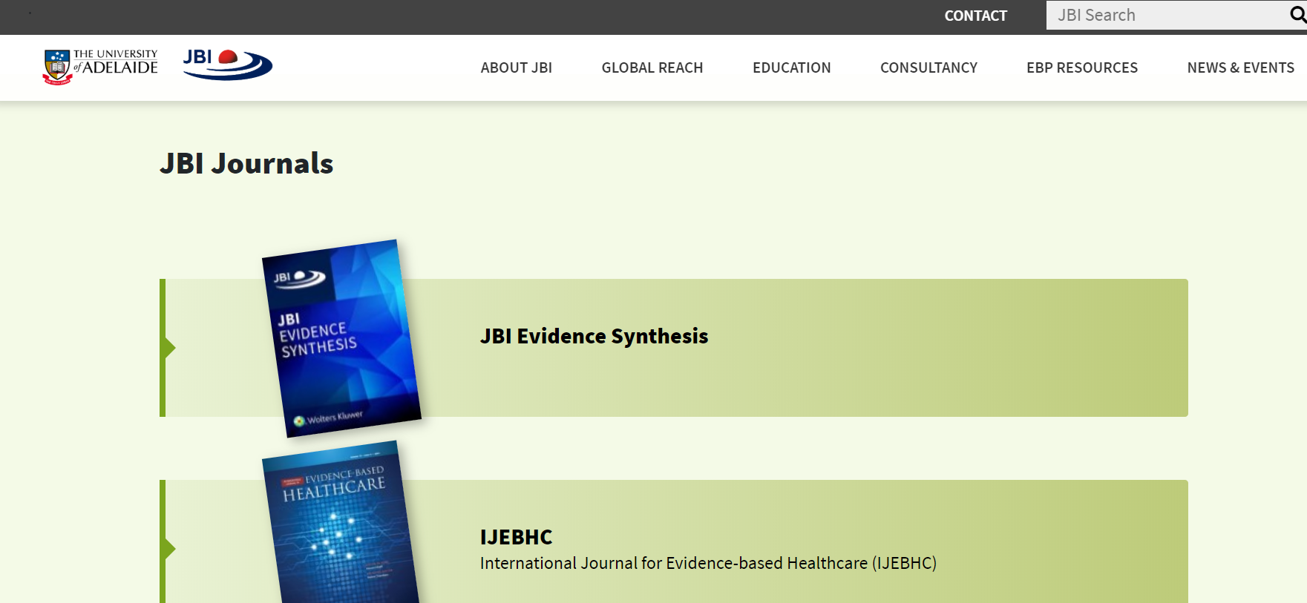
(2) JBI 的兩本雜誌
ＳＣＩ

Slide 4
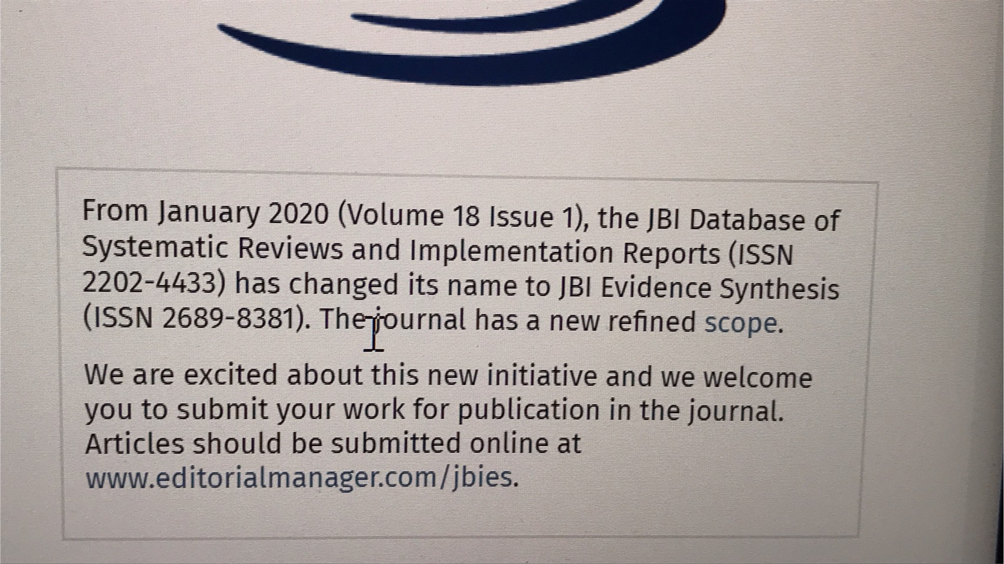
2.1. JBI Database of Systematic Reviews and Implementation Reports 更名為 Evidence synthesis

Slide 5
2.2. International Journal of Evidence-Based Healthcare 更名為 Evidence implementation
Dear Editorial Manager User,
At the end of July, the International Journal of Evidence Based Healthcare (IJEBHC) will change name to JBI Evidence Implementation (JBIEI) and will focus on publishing implementation studies and associated methodology.
The Editorial Manager site for this journal will also change and can now be found at www.editorialmanager.com/jbiei, however there will be an auto-redirect for 6 months on the existing Editorial Manager site. Please bookmark this new site. Your usernames and passwords will not change.
Please visit the journal's new homepage at www.jbievidenceimplementation.com and bookmark this page as well.
Sincerely,
Editorial Team

Slide 6
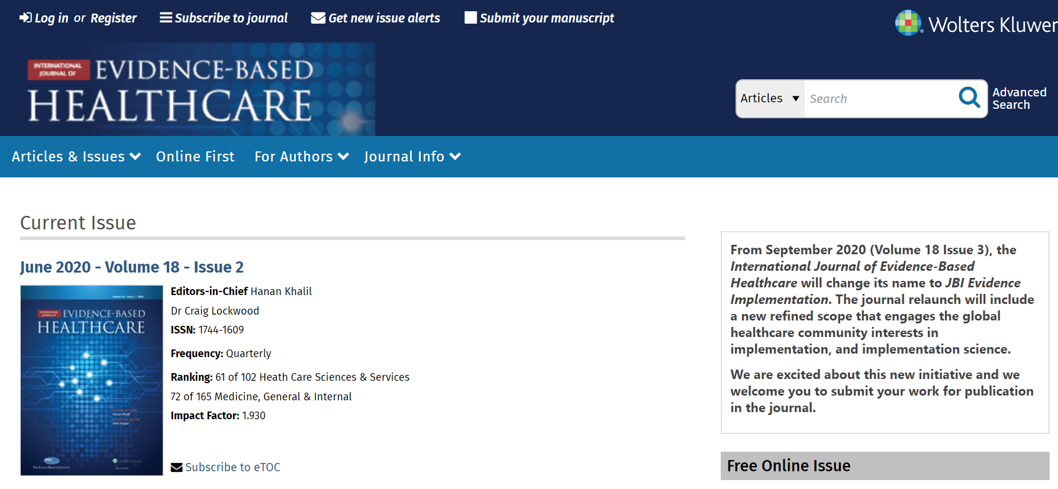
3.因為雜誌更新
大家可查詢已發表文章的現況
在查詢處,放入您的英文姓,即可查到您的發表文章,或發表於某些ＪＢＩ研討會摘要,
因為此雜誌 (JBI evidence implementation)為SCI 雜誌
大家可以更新您的CV.
另一雜誌如此類推

